Slide 1
Quora Question Pairs
COMPUTER SCIENCE AND ENGINEERING
SUDIPTA HALDER
UNIV ROLL NO – 10400116059
SMITA BANDYOPADHYAY
UNIV ROLL NO - 10400116078

Slide 2
Problem Description
100 million people visit Quora every month.
People often post the same questions but frame them differently.
We want to make content discovery easier, for better search & relevance, recommendations, autocomplete etc.
The goal is to discover whether two questions have the same intent!

Slide 3
Real world/Business Objectives and Constraints
The cost of a mis-classification can be very high.
You would want a probability of a pair of questions to be duplicates so that you can choose any threshold of choice.
No strict latency concerns.

Slide 4
Some Examples of duplicate Q pairs
What are the best destinations for solo trip in India?
What are some best places for solo trips in India?
Newton laws of motion?
What are Newton's three laws of motion?
What can make Physics easy to learn?
How can you make physics easy to learn?

Slide 5
Some Examples of non-duplicate Q pairs
What is the step by step guide to invest in share market in india?
What is the step by step guide to invest in share market?
How can I increase the speed of my internet connection while using a VPN?
How can Internet speed be increased by hacking through DNS?
What is your review of Performance Testing?
What is performance testing?

Slide 6
What’s so challenging about the task?
Look at these two questions:
The Sicilian gelato was extremely rich.
The Italian ice-cream was very velvety.
Almost no word in common between these two sentences. But they are of same content.

Slide 7
Data Overview
Data will be in a file Train.csv
Train.csv contains 5 columns : qid1, qid2, question1, question2, is_duplicate
Size of Train.csv - 60MB
Number of rows in Train.csv = 404,290

Slide 8
Type of Machine Learning Problem
It is a binary classification problem, for a given pair of questions we need to predict if they are duplicate or not.
Metric(s):
log-loss
Binary Confusion Matrix

Slide 9
Some Facts about Data
Total number of question pairs for training: 404290
Question pairs are not Similar (is_duplicate = 0): 63.08%
Question pairs are Similar (is_duplicate = 1): 36.92%
Total number of Unique Questions are: 537933
Max number of times a single question is repeated: 157
Number of duplicate question pair: 0

Slide 10
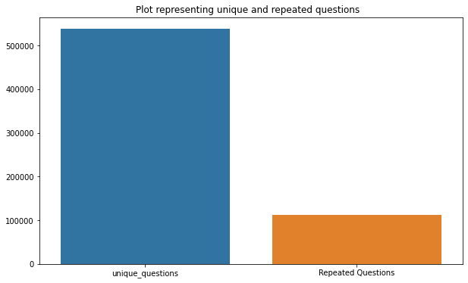

Slide 11
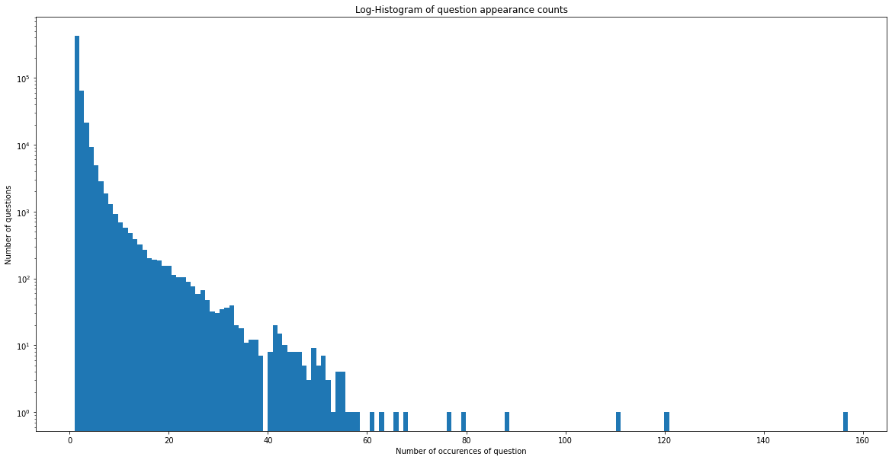

Slide 12
Basic Feature Extraction (before cleaning)
frequency_qid1 = Frequency of qid1's
frequency_qid2 = Frequency of qid2's
q1length = Length of q1
q2length = Length of q2
q1_n_words = Number of words in Question 1
q2_n_words = Number of words in Question 2
word_Common = (Number of common unique words in Question 1 and Question 2)
word_Total =(Total num of words in Question 1 + Total num of words in Question 2)
word_share = (word_common)/(word_Total)
frequency_q1+frequency_q2 = sum total of frequency of qid1 and qid2
frequency_q1-frequency_q2 = absolute difference of frequency of qid1 and qid2

Slide 13
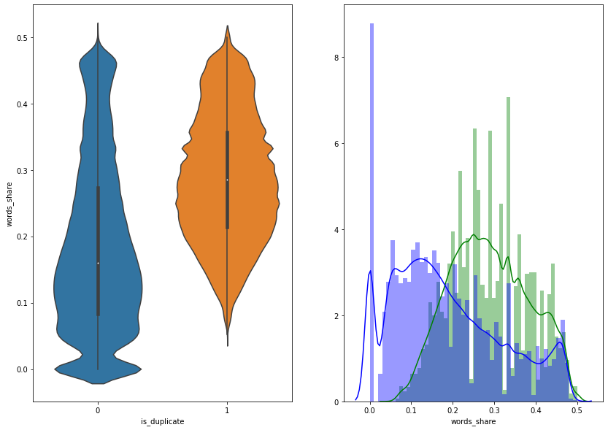
The distributions for normalized word_share have some overlap on the far right-hand side, i.e., there are quite a lot of questions with high word similarity
The average word share and Common no. of words of qid1 and qid2 is more when they are duplicate(Similar)
In case of violin plots, the 25th percentile of is_duplicate=1 just starts somewhat above from the 50th percentile of is_duplicate=0. So, they are not fully separable but partially separable with the feature 'word_share' alone

Slide 14
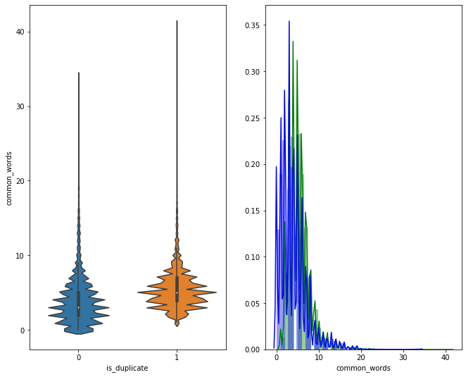
The distributions of the word_Common feature in similar and non-similar questions are highly overlapping. Hence it is almost impossible to distinguish b/w duplicate and non_duplicate with the feature 'word_common' alone.

Slide 15
Pre-processing of Text
Removing html tags
Removing Punctuations
Performing stemming
Removing Stopwords
Expanding contractions etc.

Slide 16
Advanced Feature Extraction 1. NLP Features
Token: Token is obtained by splitting sentence based on a space
Stop_Word : stop words as per NLTK.
Word : A token that is not a stop_word
cwc_min = common_word_count / (min(len(q1_words), len(q2_words))
cwc_max = common_word_count / (max(len(q1_words), len(q2_words))
csc_min = common_stop_count / (min(len(q1_stops), len(q2_stops))
csc_max = common_stop_count / (max(len(q1_stops), len(q2_stops))
ctc_min = common_token_count / (min(len(q1_tokens), len(q2_tokens))
ctc_max = common_token_count / (max(len(q1_tokens), len(q2_tokens))
Last_word_equivalent
first_word_equivalent

Slide 17
2. Fuzzy Features
Fuzz_ratio
Fuzz_partial_ratio
Token_sort_ratio
Token_set_ratio
Longest_substring_ratio
https://github.com/seatgeek/fuzzywuzzy#usage

Slide 18
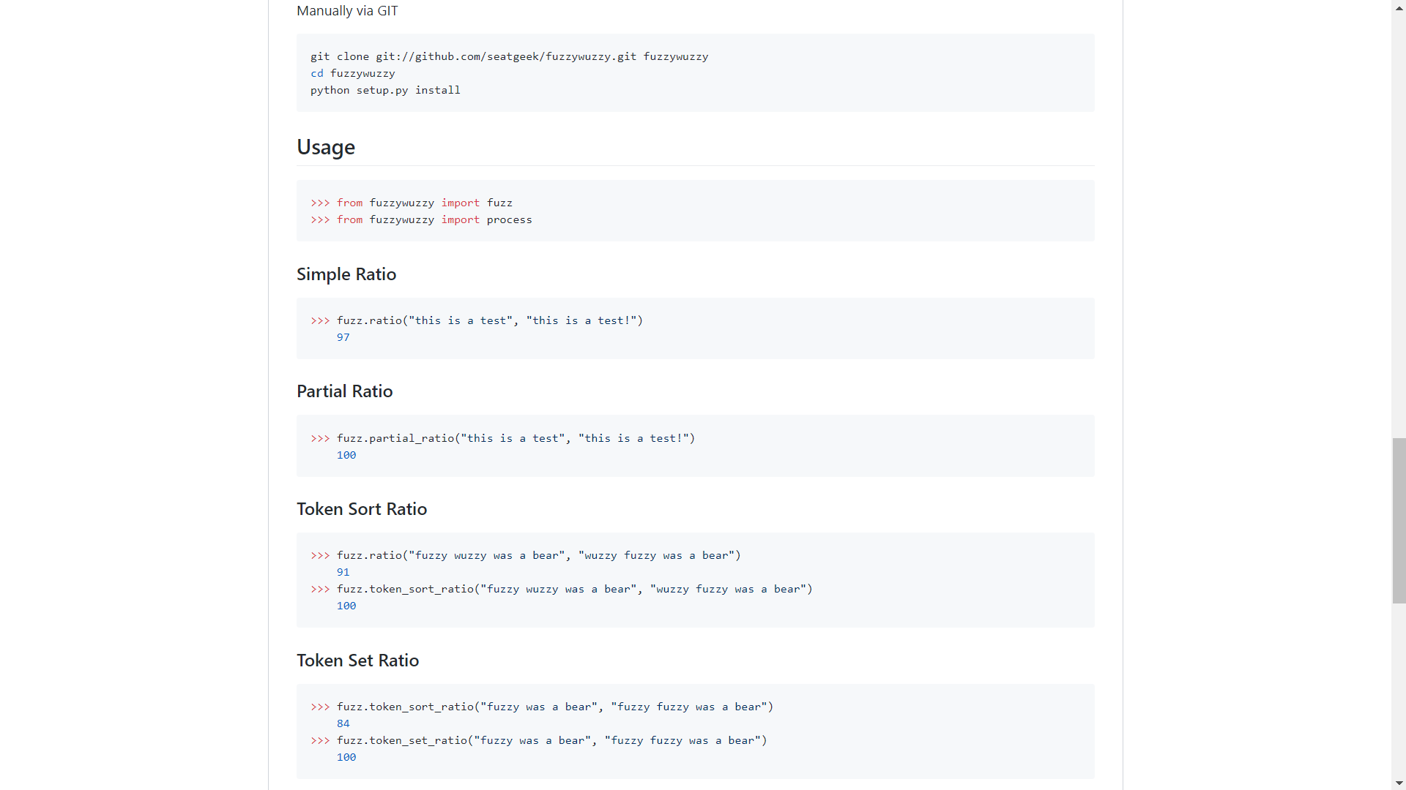

Slide 19
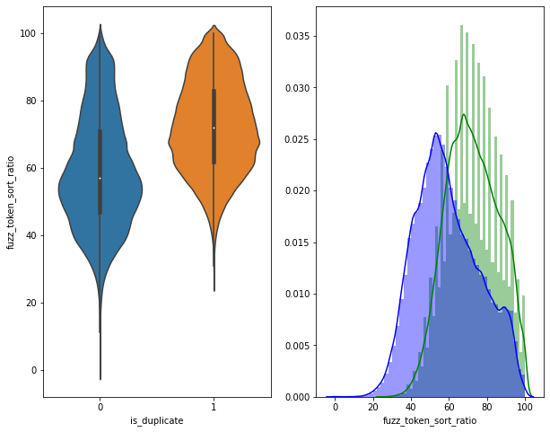
Violin Plot and pdf between fuzz_token_sort_ratio and is_duplicate
Fuzz_token_sort_ratio alone is not sufficient to separate duplicates and non-duplicates

Slide 20
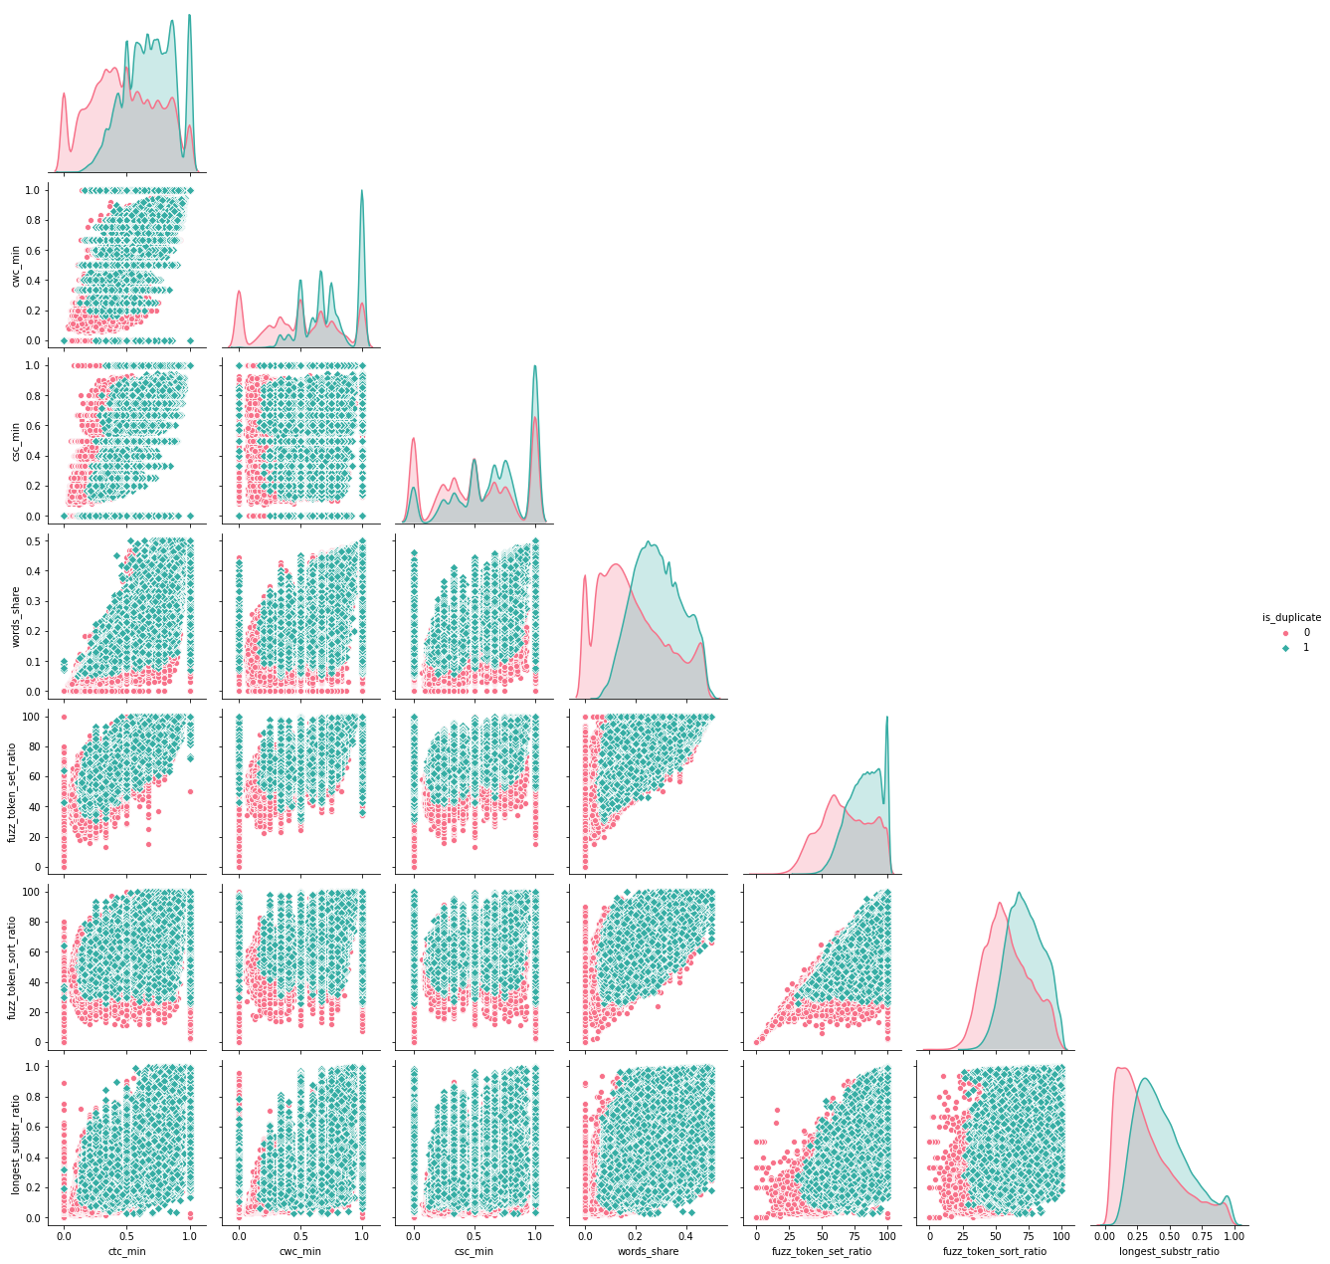
Pair plot between different basic and fuzzy features

Slide 21
Word to Vector
Word embedding is a well known natural language processing technique to map words and phrases to vectors of real numbers.
In other words, it is a mathematical embedding from one dimension per word to a continuous vector space.
We will use Google-News-Vector to convert each word in the corpus to a d-dimensional vector.
https://code.google.com/archive/p/word2vec/

Slide 22
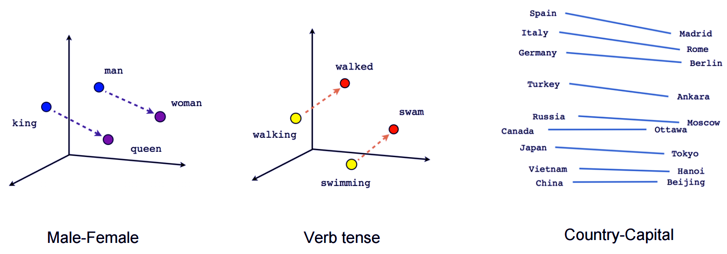
Example of Word to Vector and similarity between different words

Slide 23
Word Mover Distance
WMD is a method that allows us to assess the "distance" between two documents in a meaningful way, even when they have no words in common. It uses word2vec vector embeddings of words. It been shown to outperform many of the state-of-the-art methods in k-nearest neighbors classification.
https://markroxor.github.io/gensim/static/notebooks/WMD_tutorial.html

Slide 24
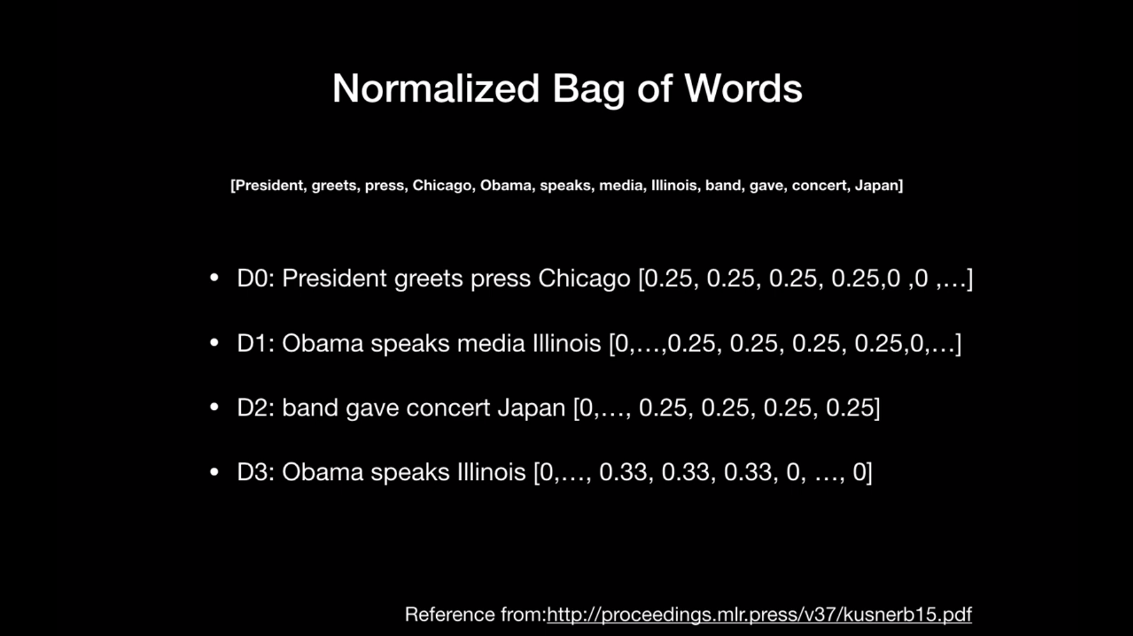
https://www.youtube.com/watch?v=nX1g_wPSYOI

Slide 25
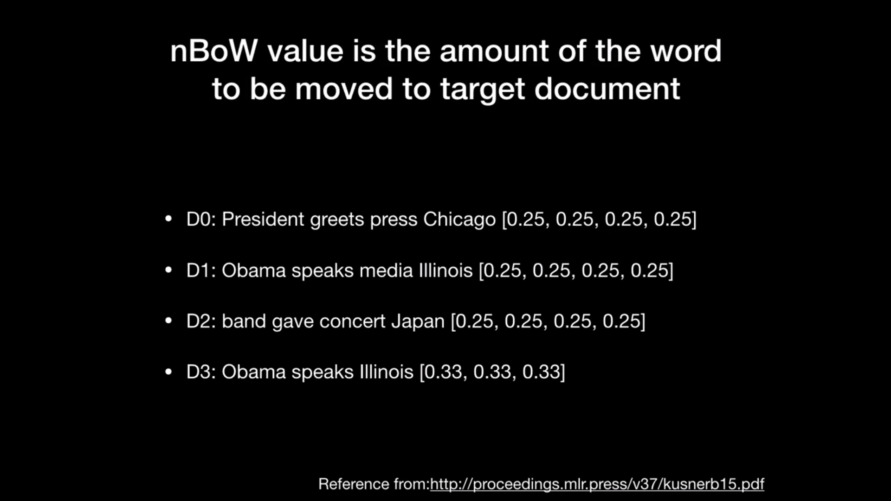
https://www.youtube.com/watch?v=nX1g_wPSYOI

Slide 26
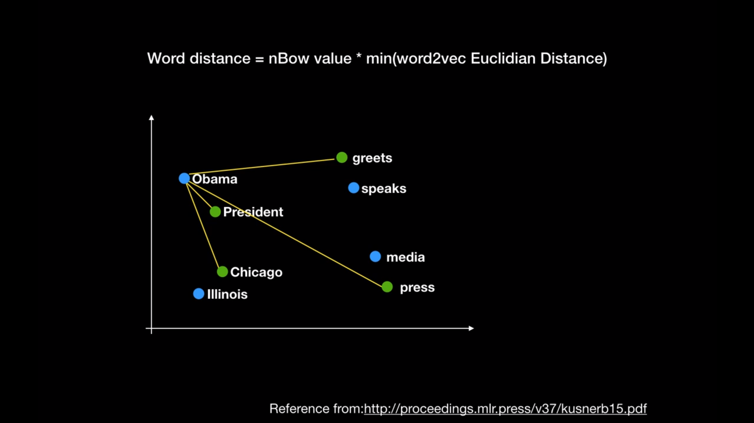
https://www.youtube.com/watch?v=nX1g_wPSYOI

Slide 27
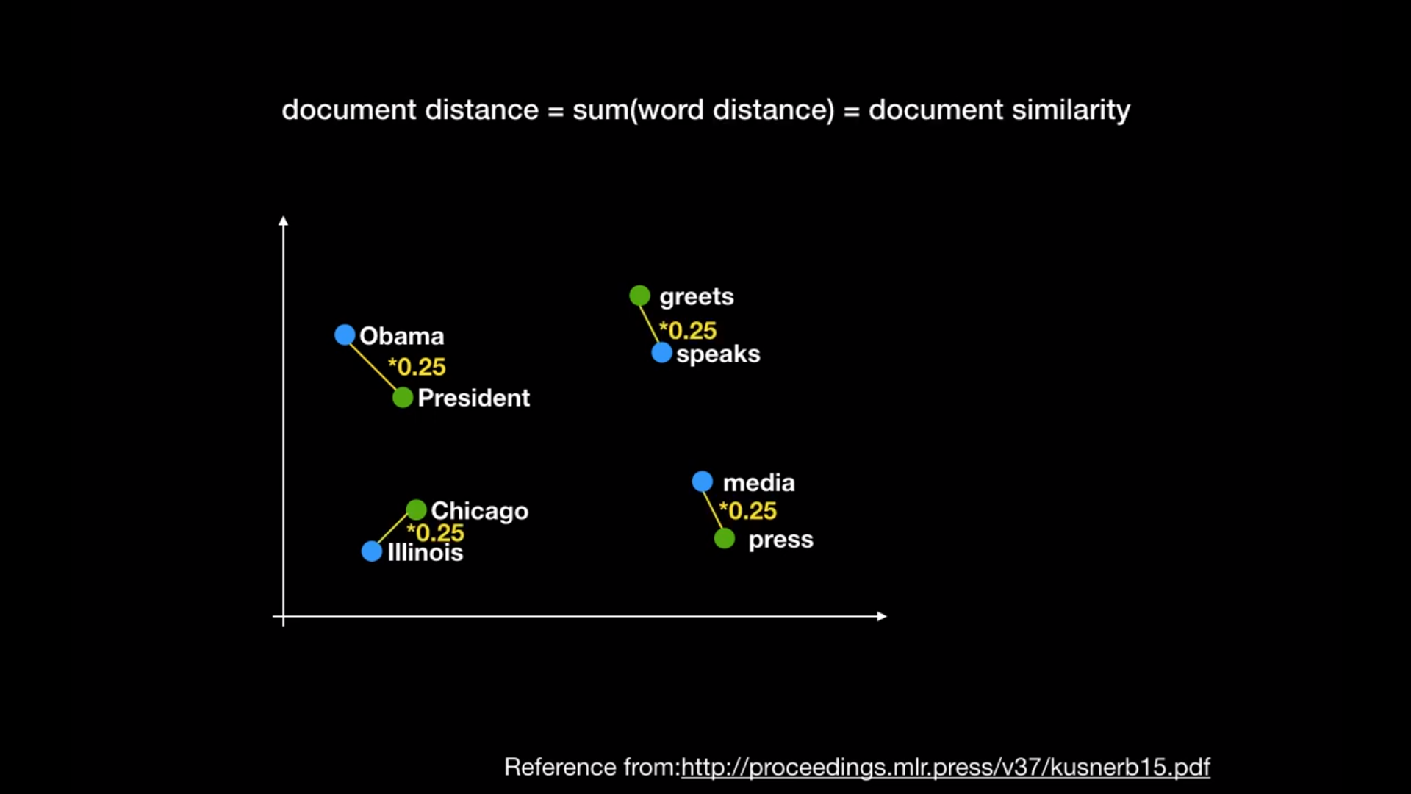
https://www.youtube.com/watch?v=nX1g_wPSYOI

Slide 28
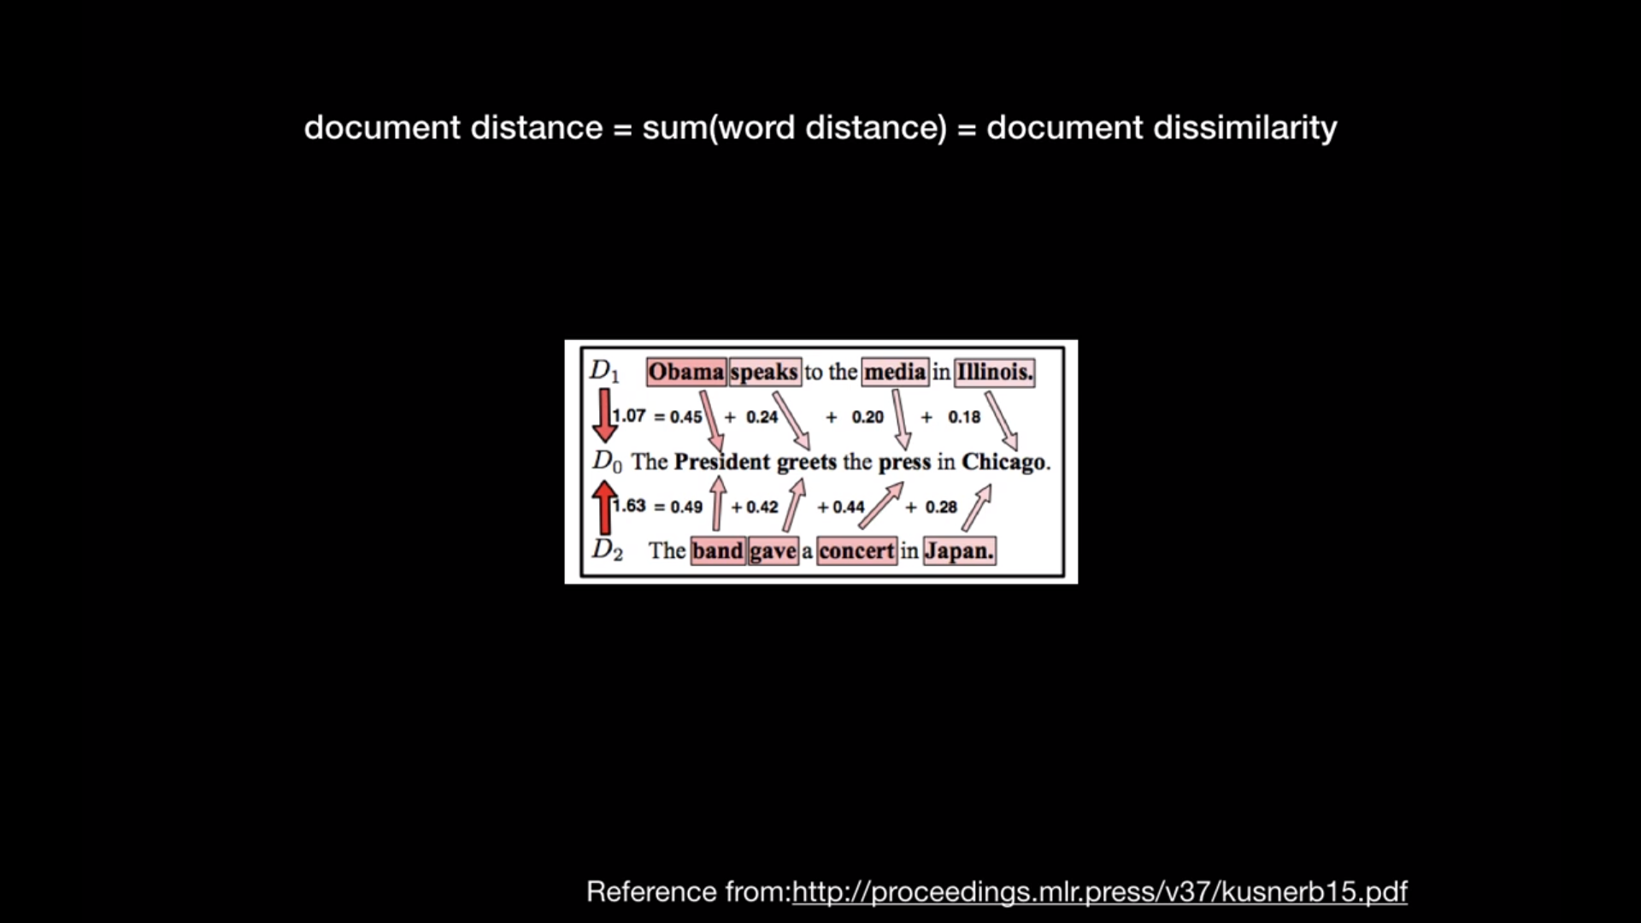
Distance of D0D1 is lesser than D0D2. Hence it will take more word edits to reach from D2 to D0 than D1 to D0. Hence D1 and D0 are more similar.
https://www.youtube.com/watch?v=nX1g_wPSYOI

Slide 29
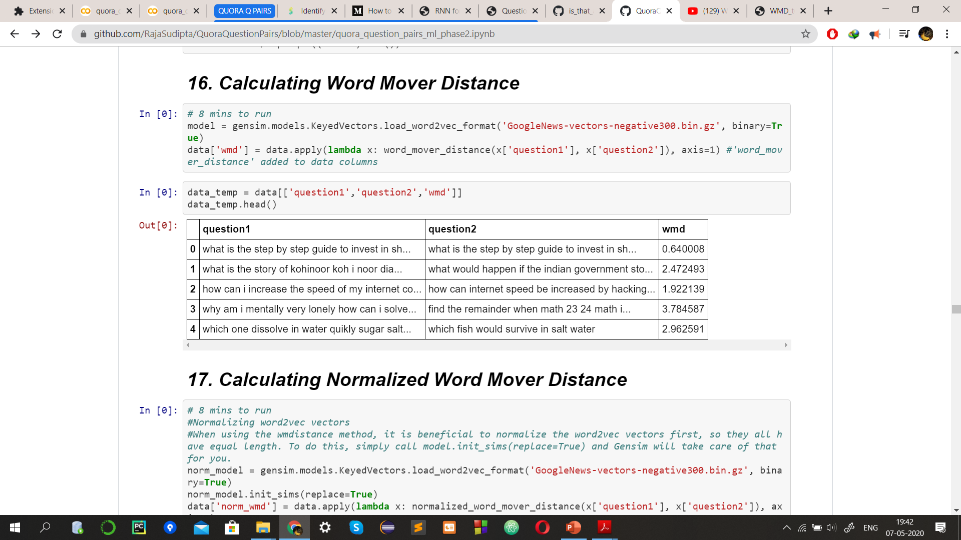
Example output of Word Mover Distance

Slide 30
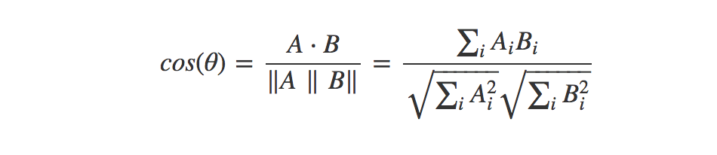
Distance Metrices
Cosine Distance

Slide 31
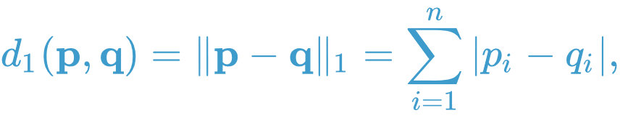
Manhattan Distance
Euclidean Distance

Slide 32
TF-IDF average Word to Vector
TF(t) = Number of times a term t appears in a document / Total number of terms in the document
IDF(t) = log(Total number of documents / Number of documents with term t in it)
TF-IDF(t) = TF(t) * IDF(t)
Qi = w1 w2 w3 … wn
TF-IDF_avg_w2Vec(Qi) = [t1*word_to_vec(w1) + t2*word_to_vec(w2) + … + tn*word_to_vec(wn)] / (t1 + t2 + t3 + … + tn), {where ti denotes tf-idf score of each word}

Slide 33
In this way, we convert each word into vector of dimension d using word to vector model using Google-News-Vector and then convert each question sentence into vector of dimension d using TF-IDF weighted average word to vector.
In our model we got 96 dimension vectors for each question sentences.

Slide 34
Total Dimensions
Basic features (11)
NLP and Fuzzy Features (18)
Qid, is_duplicate (2)
Distance Merrices(13)
Question 1 TF-IDF average weighted word to vector (96 dimensions)
Question 2 TF-IDF average weighted word to vector (96 dimensions)
Total 238 dimensions (features)

Slide 35
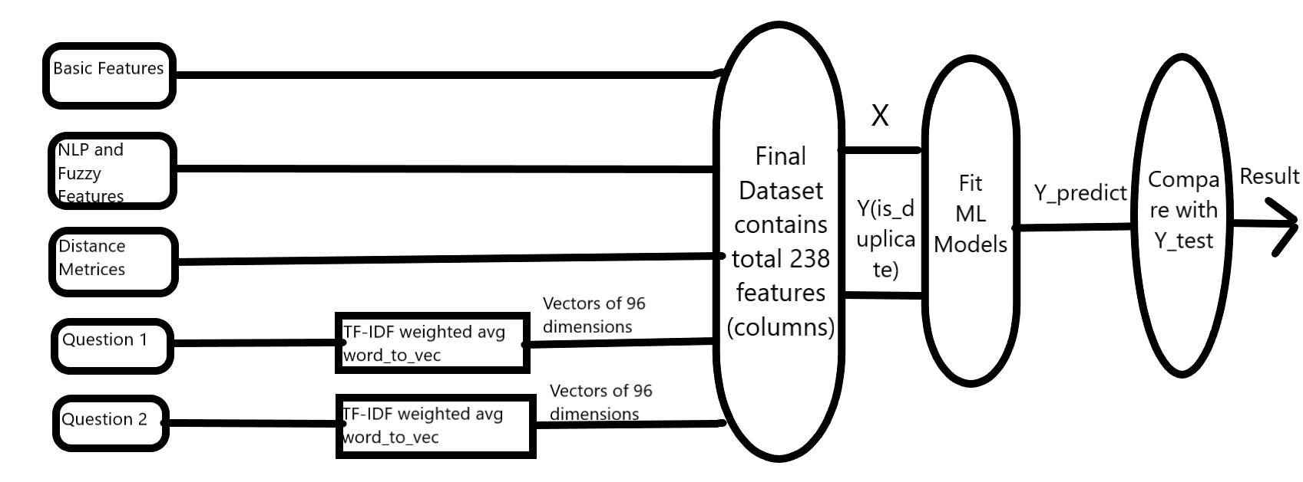
This is our implementation Model

Slide 36
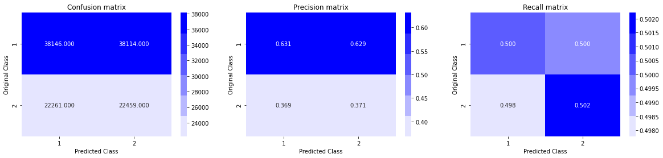
Building a Random Model
Our aim is get the worst case log loss.
Log loss on Test Data using Random Model: 0.887242646958.
It implies the worst case log loss is 0.88 and all better models should have log loss < 0.88.
Random Model is built to set a benchmark for all other better models.

Slide 37
Logistic Regression with SGD
For best alpha = 0.0002032 The train log loss is: 0.3975058281421835
For best alpha = 0.0002032 The test log loss is: 0.400262401191614
Now, since the train log loss and test log loss is almost similar, we can conclude that our Logistic Regression Model is not overfitting or underfitting. It is working correctly.

Slide 38
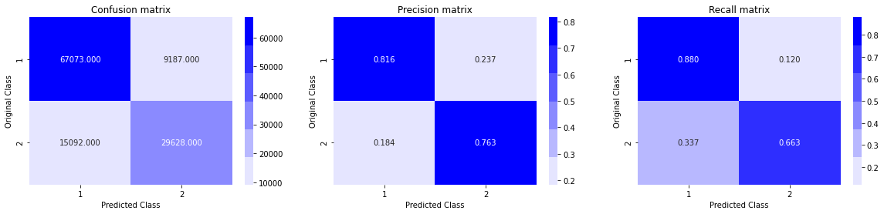
Logistic Regression Confusion Matrix Result
TPR, TNR is quite high and FPR, FNR quite low. So, model working fine.

Slide 39
Linear SVM with SGD
For best alpha = 0.0001291 The train log loss is: 0.4006189885796839
For best alpha = 0.0001291 The test log loss is: 0.40329099571822147
Now, since the train log loss and test log loss is almost similar, we can conclude that our Linear Support Vector Machine Model is not overfitting or underfitting. It is working correctly.

Slide 40

SVM Confusion Matrix Result
TPR, TNR is quite high and FPR, FNR quite low. So, model working fine.

Slide 41
Random Forest Classifier
estimators = 200 Train Log Loss 0.3415642687851075 Test Log Loss 0.37400762711869606
estimators = 300 Train Log Loss 0.342455260049411 Test Log Loss 0.3753194256730679
estimators = 400 Train Log Loss 0.342692041877361 Test Log Loss 0.3751382081822963
Now, since the train log loss and test log loss are almost similar, we can conclude that our Random Forest Classifier Model is not overfitting or underfitting. It is working correctly.

Slide 42

Random Forest Classifier Confusion Matrix Result
TPR, TNR is quite high and FPR, FNR quite low. So, model working fine.

Slide 43
Gradient Boost Decision Tree(XgBoost)
The train log loss is: 0.23062255281875668
The test log loss is: 0.31667970755105135
Now, since the train log loss and test log loss is almost similar, we can conclude that our Gradient Boost Decision Tree Model is not overfitting or underfitting. It is working correctly.
One of the best test log loss given by ML models.

Slide 44

Gradient Boost Decision Tree(XgBoost) Confusion Matrix Result
TPR, TNR is quite high and FPR, FNR quite low. So, model working fine.

Slide 45
Extra Tree Classifier
estimators = 75 Train Log Loss 0.450102611906145 Test Log Loss 0.4574824435144607
estimators = 100 Train Log Loss 0.45098598666278017 Test Log Loss 0.4579522099853415
Now, since the train log loss and test log loss is almost similar, we can conclude that our Extra Tree Classifier Model is not overfitting or underfitting. It is working correctly.
But this model is not preferred since it has slightly greater log loss in comparison to other ML models

Slide 46

Extra Tree Classifier Confusion Matrix Result

Slide 47
Stacking Classifier MlExtend
The train log loss is: 0.30921514588491233
The test log loss is: 0.34918981438080887
Now, since the train log loss and test log loss is almost similar, we can conclude that our Gradient Boost Decision Tree Model is not overfitting or underfitting. It is working correctly.
One of the best test log loss given by ML models.
It takes very long time to run.
If we can choose the parameters optimally, this model should give the best result.

Slide 48

Stacking Classifier Confusion Matrix Result

Slide 49
Adaptive Boosting
The train log loss is: 0.30921514588491233
The test log loss is: 0.5325878474916613
This model is providing the worst result. So, we do not recommend this model for this dataset.

Slide 50
Comparison of different ML models
Logistic Regression with Stochastic Gradient Descent and SVM with Stochastic Gradient Descent is working fine with test log loss 0.40.
But the best result is given by Gradient Boost Decision Tree with test log loss 0.31 and Stacking Classifier with test log loss 0.34.

Slide 51
Challenges
The final feature set is quite high dimensional hence the size of the final .csv file reached to 2 GB.
To convert the Question1 and Question2 column into TF-IDF weighted average word-to-vector it took total 2 hours.
Models like Gradient Boost Decision Tree(GBDT) and Stacking Classifier took 2-3 hours to train.
In few cases ram requirement went up to 31 GB.
In some of the ML models like GBDT and Stacking Classifier and while calculating normalized word mover distance it took almost 15 GB ram.

Slide 52
Future works
Find out more relevant features if possible.
Correct the mis-spellings.
Apply Deep Learning Models like LSTM, Bi-LSTM.

Slide 53
QUESTIONS?

Slide 54
THANK YOU

